Slide 1



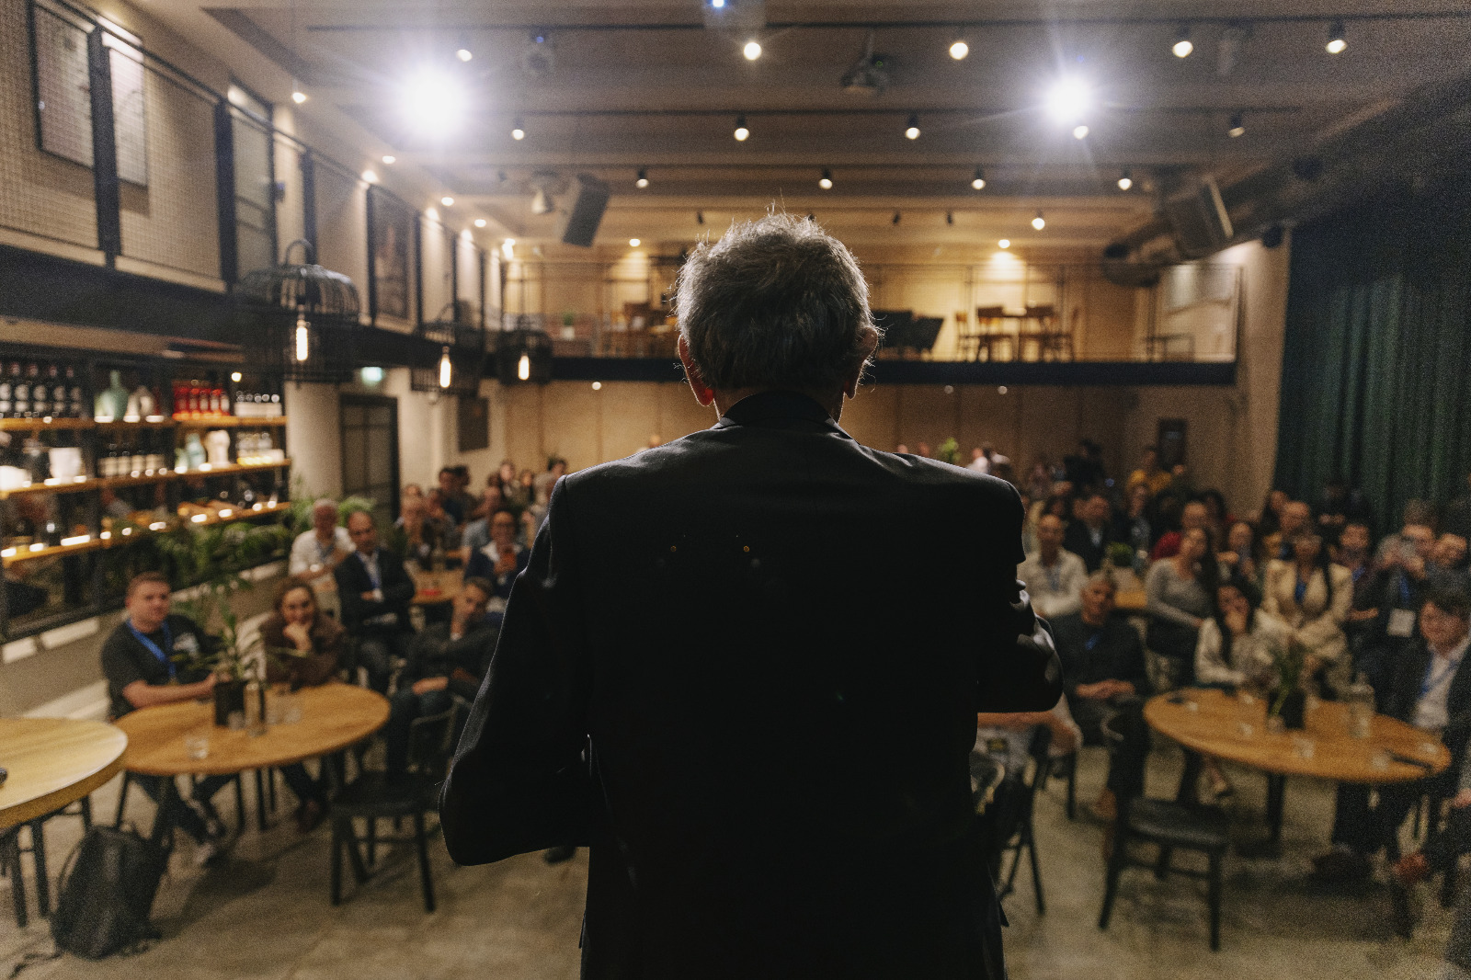
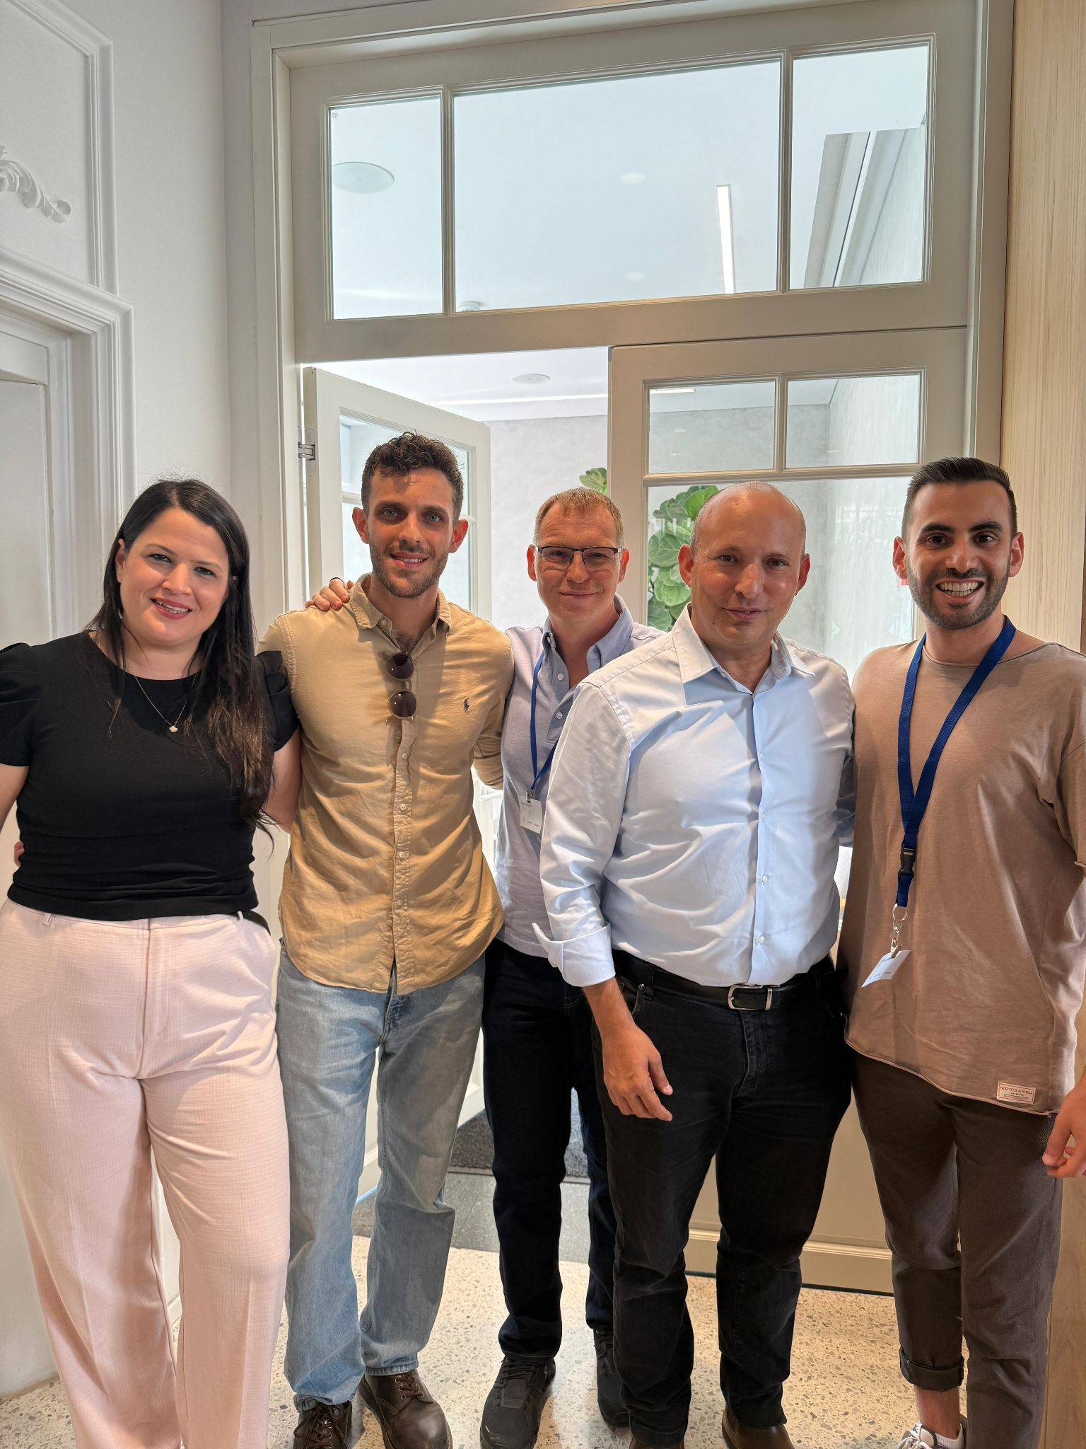
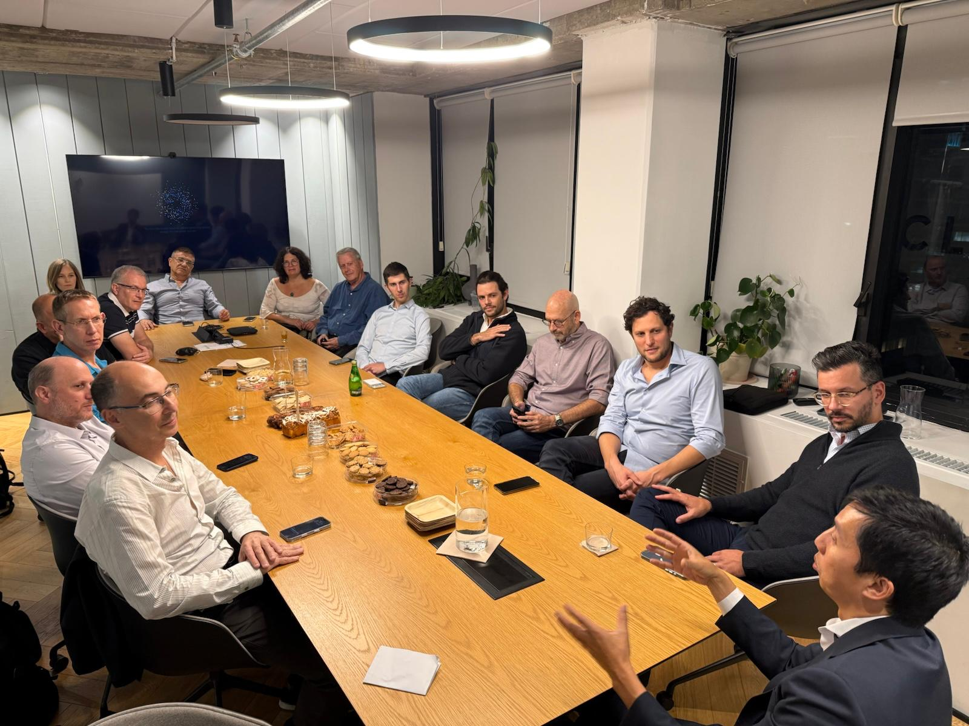
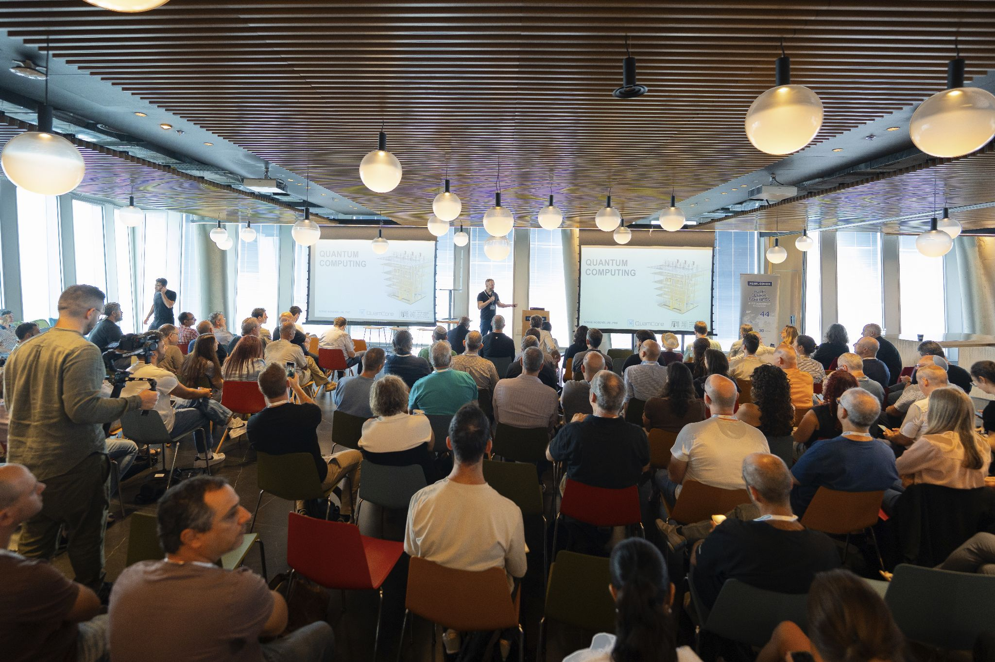

Qubit:
Building Israel's Quantum Future.
A Platform Builder for the Israeli Quantum Ecosystem
Quarter / Jan 26

Slide 2
פגישות אקוסיסטם-
אקדמיה:
מעבדת מכון ויצמן
כנסים:
vernewell group Dubai emerge Americas , Q Expo
אחרים:
סיון כהן סבן
קרנות:
אינטל קפיטל, אנטרה קפיטל
שותפים:
EY, KPMG, DELOITTE, HAREL, HF, PEARL Cohen Microsoft, POALIM Tech, Finnigan
חברות:
quantum machines, Classiq, Quantum source
(השבוע quantum source/quantum transistors)
גורמי ממשל:
נדב כהן, אביב זאבי, דרור בין, שלומי קופמן
ארגונים בין לאומיים:
QuIC, QED-C
שגרירות:
יפן, אנגליה, קוריאה
גורמים נוספים:
INSS SNC , IQCC

Slide 3

Agenda
2025 recap
Our Organizational framework
Quantum Startup Growth
Education and Certification
Community by Domain
National Knowledge Hub
Structure
Planned events
Longer terms plans
Budget
Company Name
Quarter Month
Year

Slide 4
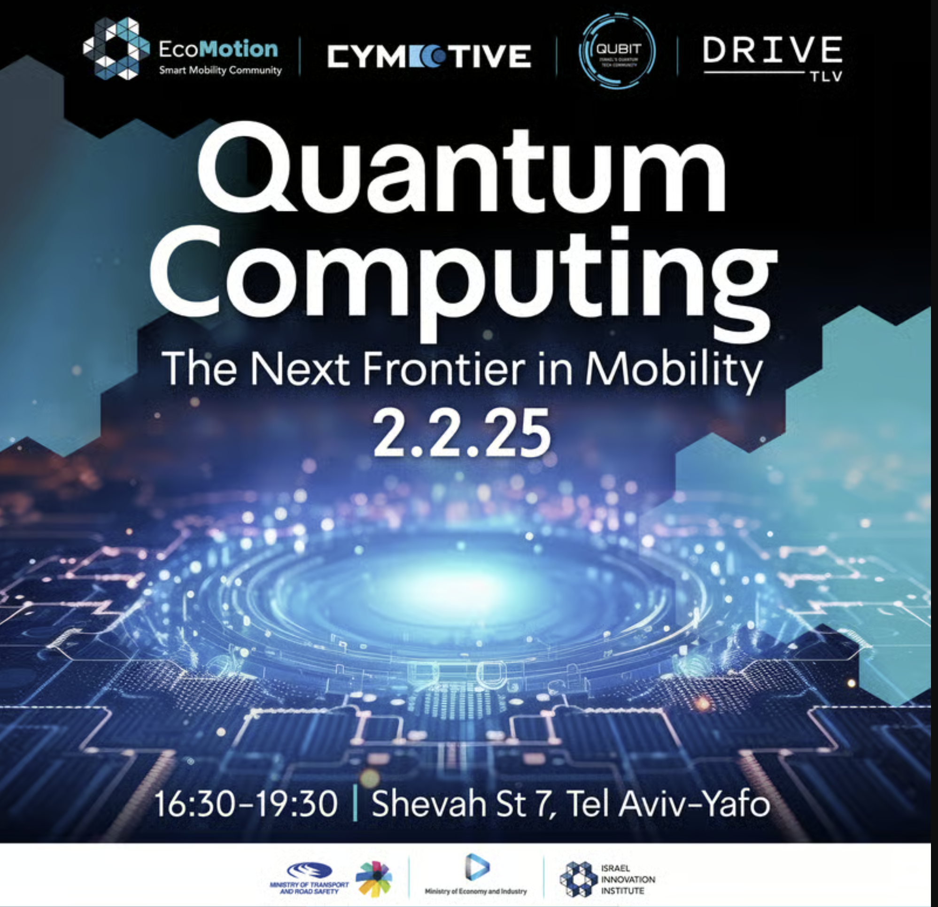
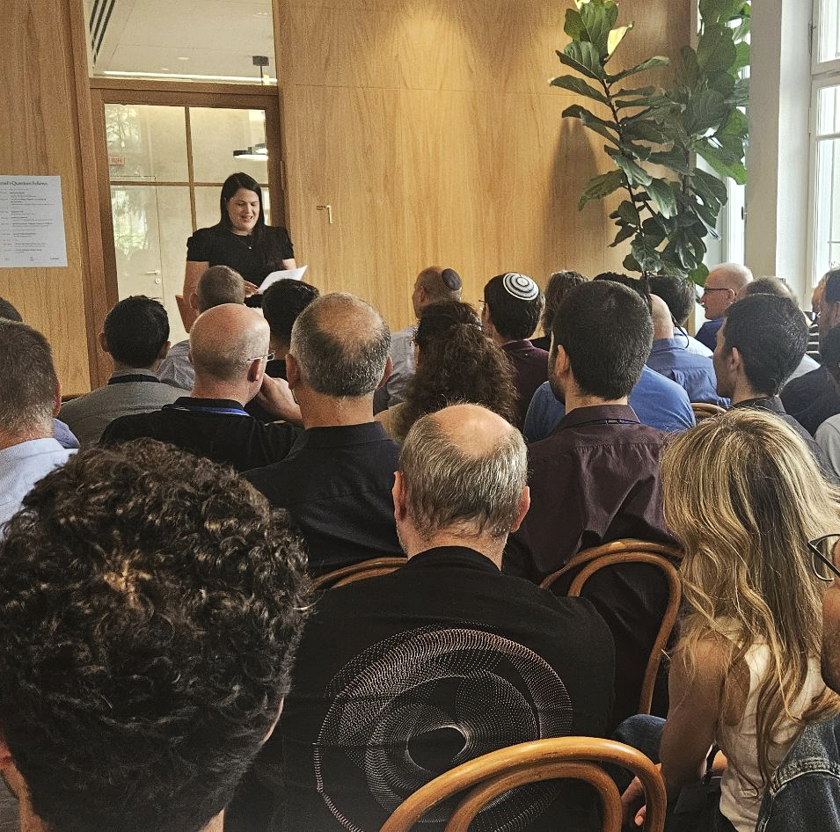


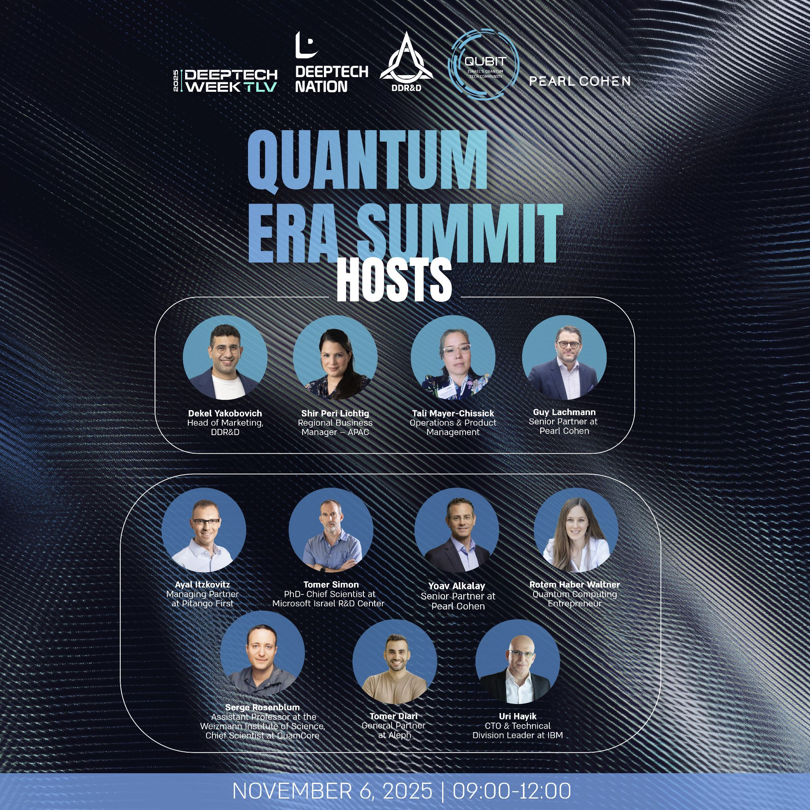


2025
What A Year!
9
Events
11
Partnerships
36
Speakers
1200
Participants
Qubit IL & QTC MeetUp
Quantum Computing
in Mobility
Quantum Israeli Fellows
Quantum for Energy
Sept 2025
Quantum Era Summit
Nov 2025
Quantum Era Summit
Nov 2025
Quantum Gala, Fireside Chat & CEO Forum
Dec 2025
Nov 2025

Slide 5





Our Organizational Framework
CORE PRINCIPLE
Qubit operates as a Platform Builder for Israel's quantum ecosystem, creating infrastructure that enables growth across all verticals.
Owner
Dedicated vertical lead
Budget
Annual allocation
KPIs
Measurable goals
Team
Core + volunteers
Review
Quarterly tracking
Company Name
Company Name
Quarter Month
Quarter Month
Year
Year

Slide 6

Quantum Startup Growth
VERTICAL 1
Resource Platform
Centralized access to government programs, grants, and funding opportunities
Mentoring
Technical and business guidance for founders
Goal
Consistently grow Israel's active quantum companies and boost their pre-Series A success rates.
Hackathons
Hardware, software, algorithms
& applications tracks
Active PR and Exposure
Company Name
Company Name
Quarter Month
Quarter Month
Year
Year

Slide 7
Activities
Hackathons
Active PR & Exposure
Resource Platform
Mentoring
An online resource index, constantly updated by Qubit IL analyst.
An ecosystem index, in collaboration with Startup Nation Central.
Free consultancy package
Technical and business guidance for founders
Connect industry and academy mentors to startup by need
Monthly events for the community to spur innovation.
Bi-annual in-depth industry focus on challenges of a specific vertical.
An annual Qubit IL hackathon.
Engage PR company - budget implications
Company Name
Quarter Month
Year

Slide 8
12-Month Startup Targets
VERTICAL 1 KPIS
+5
10+
5-8
20+
New Companies
Founded or spun-off
Founders
In active mentoring
PoCs
Founded or spun-off
Connections
Founder↔Industry/VC
KPIs will be fine tuned after we understand better the landscape.
Company Name
Company Name
Quarter Month
Quarter Month
Year
Year

Slide 9
Education & Certification
VERTICAL 2
Goal
Create a shared quantum language across the market—training developers, executives, boards, and new employees.
Developers
Practical quantum literacy
Business
Sales & BizDev readiness
Executives
Strategic decision-making
Schools
Funneling the future workforce
Company Name
Company Name
Quarter Month
Quarter Month
Year
Year

Slide 10
Workshops & Courses
Quantum Executive Overview
CTO Workshop
Developers Workshop
High School Quantum Program
1-2 hour focused lecture
Quick Quantum
Fundamentals for business leaders
Strategic insights for informed decision makers
9 hours full day intensive
Enterprise leadership
Start with Quantum fundamentals
Strategic planning Business impact
9 hours full day intensive
Technical implementation
Hands on coding
Real world tools
Interactive Quantum fundamentals
Inspire next-generation innovators
Hands on demonstrations for teenagers
Company Name
Quarter Month
Year

Slide 11
Education Targets 12 Months
KPIs
VERTICAL 2 KPIS
User Interface Improvements
+250
50
30+
40
Trained
Leaders
Organizations
Schools
Create an exclusive Quantum Fellow badge for those who are trained by sector and they will become part of a club of ambassadors
Company Name
Company Name
Quarter Month
Quarter Month
Year
Year

Slide 12

Developers
Hardware
Community by Domains.
Students
Finance
Defense
Product/Biz
VERTICAL 3
Goal
Build a vibrant, cross-disciplinary community delivering daily value- not just events.
Company Name
Quarter Month
Year

Slide 13

Community Platforms
1416
Members
540
Subs
1200
Followers
600
Members
52
Newsletters
sent to date
Planned: Consider additional Discord/ Slack for developer
WIP- Quantum Podcast serie

Slide 14




National Knowledge Hub
VERTICAL 4
Content Hub/
200+ resources
Video Library/
100+ tutorials
Goal
Become the one-stop-shop for quantum applications, use cases, and best practices.
Podcast
10-20 episodes
Case Studies
Real-world applications
Company Name
Company Name
Quarter Month
Quarter Month
Year
Year

Slide 15
Structure
Verticals
Head of
Quantum startup Growth
Head of
Education & Certificants
Head of
Community & Volunteers
Head of
National Knowledge Hub
Ecosystem & Programs
Tali Mayer chissick
Community operations & Content
Dror Pezo
Marketing & Operation
Calanit Ozeri
Operations
Events
Workforce
Dafna Meir
Website- Yahel Cohen
Marketing content-
Shiraz Adin
Education & Certificants
Gilad Levi
Academy to industry
Tsafrir Levi
Qubit for Developers
Paz Shakroka
Branding-
Noa Mekler
Company Name
Quarter Month
Year

Slide 16
Volunteering teams
Ecosystem & Programs - Tali Mayer chissick
Workforce - Dafna Meir, Boaz Raz, Amit Hayut,Riki Hihinashvili
Academy <-> Industry relationship - Tsafrir Levi Yael Tarmin, Amit hayut, Ori Solomon, Boaz Raz
Qubit for Developers - Paz Shakroka, Nadav Ben-Ami
Volunteers manager - Roy Lehana
Community operations & Content - Dror Pezo
Team-Shiraz Adin, Boaz Raz, Alon Davidy
Education & Certificants - Gilad Levi
Team- Alon Davidy, Boaz Raz, Yael Termin,
Guy Etgar, Riki Hihinashvili
Marketing & Operation - Calanit Ozeri
Website - Yahel Cohen
Team- Avichay Ben Lulu, Or Robin, Shira Zorin
Marketing content - Shiraz Adin
Branding & Design - Noa Mekler

Slide 17
Q1 & Q2 2026 Planned events
01 / January
02 / February
03 / March
04 / April
19/1
Webinar Quantum developers
29/1
Meetup - Spark
2/2
Webinar - Bank Hapoalim
Webinar - Rami Belchman
Webinar for the community
23/2
Face to face meetup for developers
CTO forum meetup at Bar-Ilan university
Quantum safe for energy event
Psagot alumni quantum meetup
Dubai Conference
05 / May
Community event
Company Name
Quarter Month
Year

Slide 18
Quantum national visitor center
Israel Quantum week
Joint governmental programs
International collaborations
Longer term plans

Slide 19
Budget
2026/
2-3M NIS
CEO Salary (cost)
Operations manager
Head of verticals
Admin
PR
Incorporation and registration
Audit and legal (including HR)
Ongoing design and marketing needs
Office (?) in Shared space can also find pro bono option
6 yearly local events
International Event
Overhead 20%
Company Name
Company Name
Quarter Month
Quarter Month
Year
Year

Slide 20
4
1
∞
Verticals
Platform
Potential
Let's Build the
Quantum Ecosystem Together

Slide 21

THANK YOU!

Slide 22

Global exposure and positioning of Israel Ecosystem
KPIs
VERTICAL 2
Qubit as Operator
User Interface Improvements
Participating as Israel ecosystem in global events
Maintaining an updated portfolio of the industry
Communication with similar organizations in key geographies
KPIs
Goal
Position Israel Quantum industry as part of the 7 leading global quantum ecosystems.
Participating in 4 leading conferences
Pushing publications of Israel's startup in leading platforms
Company Name
Company Name
Quarter Month
Quarter Month
Year
Year

Slide 23
International collaborations
Joint governmental programs
Israel Quantum week
Quantum national visitor center
Longer term plans

Slide 24
THANK YOU!

Slide 25
THANK YOU!

Slide 26


Qubit: Building Israel's Quantum Future.
A Platform Builder for the Israeli Quantum Ecosystem
Quarter / Jan 26

Slide 27
Qubit:
Building Israel's Quantum Future.
A Platform Builder for the Israeli Quantum Ecosystem
Quarter / Jan 26

Slide 28

Qubit:
Building Israel's Quantum Future.
A Platform Builder for the Israeli Quantum Ecosystem
Quarter / Jan 26

Slide 29

Qubit: Building Israel's Quantum Future.
A Platform Builder for the Israeli Quantum Ecosystem
Quarter / JAN 26

Slide 30
Content
Add section title
Add section title
Add section title
Add section title
Add section title
Add section title
Add section title
Company Name
Quarter Month
Year

Slide 31




KPIs
250+
30+
Trained
Organizations
Individuals certified
In programs
50
40
Leaders
Schools
Executives & directors
Company Name
Company Name

Slide 32




Quantum Startup Growth
VERTICAL 1
User Interface Improvements
Resource Platform
Centralized access to government programs, grants, and funding opportunities
Mentoring
Technical and business guidance for founders
Goal
Consistently grow Israel's active quantum companies and boost their pre-Series A success rates.
Hackathons
Hardware, software, algorithms
& applications tracks
Active PR and Exposure
Company Name
Company Name
Quarter Month
Quarter Month
Year
Year

Slide 33
12-Month Startup Targets
VERTICAL 1 KPIS
+5
10+
5-8
20+
New Companies
Founded or spun-off
Founders
In active mentoring
PoCs
Founded or spun-off
Connections
Founder↔Industry/VC
Company Name
Company Name
Quarter Month
Quarter Month
Year
Year

Slide 34

Planned events
01 / January
02 / February
03 / March
Webinar - Bank Hapoalim
19/1
Webinar Quantum developers
29/1
Meetup - Spark
Webinar - Rami Belchman
Webinar for the community
23/2
Face to face meetup for developers
Safe quantum event
04 / April
Dubai
05 / May
Community event
Company Name
Quarter Month
Year

Slide 35
Planned events
January
Webinar - Bank Hapoalim 19/1 Webinar Quantum developers 29/1 Meetup - Spark
February Webinar - Rami Belchman Webinar for the community 23/2 Face to face meetup for developers
March
Safe quantum event …
April Dubai
May
Community event
Company Name
Quarter Month
Year

Slide 36
Global exposure and positioning of Israel Ecosystem
KPIs
VERTICAL 2
Qubit as Operator
User Interface Improvements
Participating as Israel ecosystem in global events
Maintaining an updated portfolio of the industry
Communication with similar organizations in key geographies
KPIs
Goal
Position Israel Quantum industry as part of the 7 leading global quantum ecosystems.
Participating in 4 leading conferences
Pushing publications of Israel's startup in leading platforms
Company Name
Company Name
Quarter Month
Quarter Month
Year
Year

Slide 37

Education & Certification
VERTICAL 3
User Interface Improvements
Goal
Create a shared quantum language across the market—training developers, executives, boards, and new employees.
Developers
Practical quantum literacy
Business
Sales & BizDev readiness
Executives
Strategic decision-making
Schools
Funneling the future workforce
Company Name
Company Name
Quarter Month
Quarter Month
Year
Year

Slide 38
Education & Certification
VERTICAL 3
User Interface Improvements
Goal
Create a shared quantum language across the market—training developers, executives, boards, and new employees.
Developers
Practical quantum literacy
Business
Sales & BizDev readiness
Executives
Strategic decision-making
Schools
Funneling the future workforce
Company Name
Company Name
Quarter Month
Quarter Month
Year
Year

Slide 39
National Knowledge Hub
VERTICAL 5
User Interface Improvements
Content Hub/
200+ resources
Video Library/
100+ tutorials
Goal
Become the one-stop-shop for quantum applications, use cases, and best practices.
Podcast
30-40 episodes
Case Studies
Real-world applications
Company Name
Company Name
Quarter Month
Quarter Month
Year
Year

Slide 40


Meet the team
Full Name
Full Name
Full Name
Full Name
Title
Title
Title
Title
Full Name
Full Name
Full Name
Full Name
Title
Title
Title
Title
Company Name
Quarter Month
Year

Slide 41

Budget
2026/
2-3M NIS
CEO Salary (cost)
Operations manager
Training manager
PR
Incorporation and registration
Audit and legal (including HR)
Ongoing design and marketing needs
Office (?) in Shared space can also find pro bono option
6 yearly local events
International Event
Overhead 20%
Company Name
Company Name
Quarter Month
Quarter Month
Year
Year

Slide 42
Meet the team
Full Name
Full Name
Full Name
Full Name
Title
Title
Title
Title
Write a brief bio mentioning their background, area of expertise, and what their role in this partnership will be.
Write a brief bio mentioning their background, area of expertise, and what their role in this partnership will be.
Write a brief bio mentioning their background, area of expertise, and what their role in this partnership will be.
Write a brief bio mentioning their background, area of expertise, and what their role in this partnership will be.
Company Name
Quarter Month
Year

Slide 43

Write a bold, compelling statement about what the company wants to achieve.
Our mission
Company Name
Quarter Month
Year

Slide 44

Write a bold, compelling statement about what the company wants to achieve.
30+
1,000+
100+
Leadership
Synergy
Events with global thought leaders.
members in our super-active WhatsApp community
Participants taking part in Israel’s first quantum hackathon
C-suite leaders across finance, energy, healthcare, etc
Collaboration with the Israel Innovation Authority and national quantum leadership.
Our mission
Company Name
Quarter Month
Year

Slide 45
Our mission
Headline
ADD TEXT
ADD TEXT
ADD TEXT
ADD TEXT
ADD TEXT
ADD
ADD
ADD
ADD TEXT
ADD
ADD TEXT
Rank 1
Rank 1
Rank 1
Company Name
Quarter Month
Year

Slide 46



Write a bold, compelling statement about what the company wants to achieve.
Our mission
Explain how a partnership would help make this goal a reality and why it’s worth pursuing together. Think about how your potential partner can contribute.
Company Name
Quarter Month
Year

Slide 47

What we do
Our mission
Describe your company’s products and services. Keep your potential partner in mind. What do you offer that’s relevant to their business?
Company Name
Quarter Month
Year

Slide 48

Highlight your company’s growth, metrics, awards, and achievements.
00%
#00
Our accomplishments
Certifications
Industry award
Product or campaign
Market share
“Quote from published media coverage about your company”
Link to article
Rank in the industry
Company Name
Quarter Month
Year

Slide 49
Partnership Proposal Presentation
Our accomplishments
Company Name
Company Name
Quarter Month
Quarter Month
Year
Year

Slide 50
Partnership Proposal Presentation
Our accomplishments
Company Name
Company Name
Quarter Month
Quarter Month
Year
Year

Slide 51
Headline: Simplifying the user interface for new casual users
Rank 1
INSIGHTS
User Interface Improvements
500M
Monthly ….
50,000
Users
Users have expressed that the current interface is not intuitive, leading to confusion and inefficiencies. Common feature requests include a more streamlined layout, easier navigation, and clearer labeling of functions.
10M
Average Handle Time (AHT)
Company Name
Company Name
Year
Year

Slide 52
Value 1
60 /Medium/ Bold
Used for secondary or tertiary headings.
Value 2
40/ Medium/ Bold
Used for medium-sized numbers
or values.
FONT-
INTER-
REGULAR/ MEDIUM/ BOLD
Title
48/Medium
Used for large display of text.
Heading 1
36/Medium
Used for medium-sized bodies of text.
Heading 2
30/Medium
Used for medium-sized main headings.
Heading 3
16 /Medium
Used for secondary or tertiary heading
Paragraph 1
14 / Normal
Used for large bodies
of text.
Paragraph 2
12/ Normal
Used for medium-sized bodies of text.
Paragraph 3
10/ Normal
Used for medium-sized bodies of text.
Paragraph 4
8/ Medium
Used for small bodies
of text.Used for supplementary information, details,
or captions.
Company Name
Company Name
Quarter Month
Quarter Month
Year
Year

Slide 53
Color palette
Text palette
Company Name
Company Name
Quarter Month
Quarter Month
Year
Year

